Slide 1
Deep Medicine
Authored by Eric Topol
Presented by Cory davis

Slide 2
Contents
Deep Medicine vs Shallow Medicine
Medical Diagnosis
Brief History of Deep Learning
Liabilities of AI in Medicine
Applications of AI in Medicine
Deep Empathy
Conclusion

Slide 3
Deep Medicine
Deep Phenotyping
whole-genome sequencing
deeply define each individual
thick and long
Deep Learning
Using AI and ML to determine diagnosis and treatments
Baby boy experienced seizures
Combining DP and DL found he was lacking in Vitamin B6
Deep Empathy and Connection
Bringing back personal “care”
Time spent between Doctors/Patients is at an all time low

Slide 4
Shallow Medicine
Doctors are too busy with too many patients
Topol was told by his orthopedist he should be prescribed anti-depressants as a result of his knee pain (Arthrofibrosis)
Emotional breakdown (superficial contact) between patient and doctor
Can lead to mistaken or excessive diagnosis
Leading to unnecessary or incorrect tests or treatments
30-50% of 80million/year CT scans are unnecessary
American Board of Internal Medicine Foundation (ABIMF) – Choosing Wisely initiative, goal to reduce unnecessary tests

Slide 5
Shallow Medicine
Primary factors for failure
physicians overestimate the benefits of what they do
the lack of any mechanism to affect change in physicians’ behavior
No patient-driven demand for better, smarter testing
American Heart Association and American College of Cardiology changed the definition of high blood pressure
Led to 30 million more Americans diagnosed with hypertension
This was done “despite the lack of any solid evidence to back up this guideline”

Slide 6
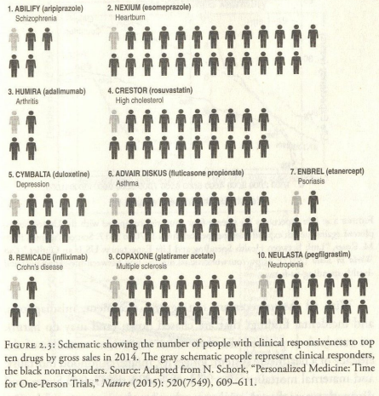
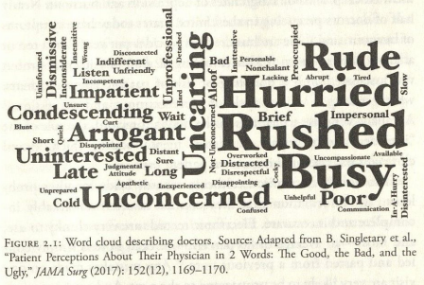
Shallow Medicine

Slide 7
Medical Diagnosis
System 1 thinking
Automatic, quick, intuitive, effortless
Uses heuristics, or rules of thumb
System 2 thinking
Slow, reflective process involving analytic effort
Accuracy of diagnosis in under 5 min: 98%
Accuracy of diagnosis after 5 min: 25%
12 million serious diagnostic errors each year in the US

Slide 8
Medical Diagnosis
Potential Cognitive Biases
10,000 human diseases
Doctors cannot know that many, and will miss diagnosis based upon with what they are familiar
“80 percent of doctors don’t think probabilities apply to their patients”
No mechanism for providing doctors with feedback on their accuracy
Many attempts to crowd source diagnosis via phone apps
One yielded 84% accuracy, but author is not encouraged by that

Slide 9
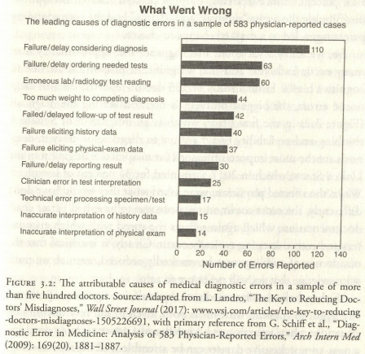
Medical Diagnosis

Slide 10
Brief History of Deep Learning
1936 – Turing Paper
1955 – Artificial Intelligence coined by John McCarthy
1964 – ELIZA, the first chatbot
1986 – First Multilayer Neural Network
1989 – Convolutional NN
1991 – Language processing NN
1997 – Deep Blue wins in Chess
2004 – Self Driving Vehicle
2011 – IBM vs. Jeopardy! Champions

Slide 11
Brief History of Deep Learning
2011 – Speech recognition NN
2012 – ImageNet classification and video recognition
2014 – DeepFace facial recognition (Facebook)
2015 – DeepMind beats Breakout and 40 other Atari games
2016/17 – Alpha Go and Alpha Go Zero
30 million training games
Reduced to 5 million games by itself
2017 – Libratus beats poker champions
Applied largely to games, images, voice and speech, and driverless cars

Slide 12
Deep Liabilities
NN Limits
Good at narrow specific tasks
Cannot compete at “general intel and common sense of a toddler”
Too often people believe AI “thinks” like a human
Black Boxes
The models are built, but how they work is unknown
Certain fields (medicine) shouldn’t rely on black box AI
AI is being used to determine how AI works
EU General Data Protection Regulation (2018)
Explanations must be given for decisions from automated systems

Slide 13
Deep Liabilities
The Blurring of Truth
AI can create and perpetuate fake images, videos, and audio
Facebook – Cambridge Analytica
Privacy & Hacking
Facial data is everywhere now, 50% of adults have their face in police accessible database
Medical data could potentially be used for advertisements
Google owns Deep Mind
AI vs AI

Slide 14
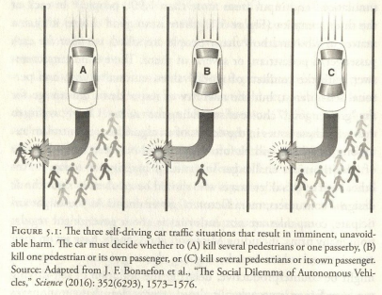
Deep Liabilities

Slide 15
Deep Liabilities
Ethics and Public Policy
Should AI progress be slowed down
Driverless car “3 choice” dilemma with no “right” answer
Does AI require an ethics board?
Jobs
AI changes how people work
Projected 19 million jobs lost but 21 million new jobs created in the next 15 years
What to do about this transition

Slide 16
Deep Liabilities
Existential Threat
Could AI destroy humans?
Terminator, Ex Machina, 2001: A Space Odyssey, The Matrix
Stephen Hawking, Elon Musk, Henry Kissinger, and Bill Gates say yes
Alan Bundy, Mark Zuckerberg say no
Musk and Sam Altman founded Open AI to work for safer AI
Issue isn’t will life become extinct but how will AI change it

Slide 17
Doctors and Patterns
Currently radiologists that read X-rays or CT scans don’t see patients
Only send reports on the image
Deep Learning can be used to read these scans
This would allow the radiologists to have 1on1 time with patients to discuss the scan
Radiologists rely on System I reflex thinking
This can sometimes lead to “inattentional blindness”
Superimposed picture of a man in a gorilla suit, with 83% of radiologists missing it
31% of radiologists experience a malpractice claim
False positives: 2%
False negatives: 25+%

Slide 18
Doctors and Patterns
While Deep Learning can analyze the images, radiologists can provide a holistic assessment that the machines cannot do.
It will help a radiologist with the job, and could allow them to discuss the test with the patient, or advice patients away from unnecessary testing
Pathologists are using similar DL to make more accurate tests for lung cancers.
While test accuracy has gone up, false positives are still higher than humans
In Dermatology, IBM Watson and CNNs performed as good or better than dermatologists

Slide 19
Clinicians Without Patterns
AI can help with Electronic Health Records (EHR)
Eye Doctors
Retinal imaging for diabetes patients
Identifying cases of Diabetic Retinopathy (#1 global cause of vision loss)
Google’s CNN
Sensitivity of 87 to 90 percent
Specificity of 98 percent
IBM’s CNN
Accuracy of 86 percent
Track and predict age-related macular degeneration (AMD), diabetic retinopathy, glaucoma, cataracts, and Alzheimer's

Slide 20
Clinicians Without Patterns
Heart Doctors
Reading ECG and echocardiography (echo)
ECG algorithms assessed in 1991 yielded accuracy of 69% (poor), same algorithms are still routinely used today
ECG AI is relatively young and unreliable
Rule based AI
Recent development DNN to diagnose heart attacks
Sensitivity 93%
Specificity 90%
34-layer CNN by Stanford
Outperformed 6 cardiologists for most arrhythmia categories
Aggregate positive predictive values between 70-80%
ECG with Apple Watch
Record activity in real word environments

Slide 21
Clinicians Without Patterns
Cancer Doctors
AI sequencing native DNA, tumor DNA, and tumor RNA
IBM Watson
Yielded “hyperbolic results”
Did not represent cognitive computing
Matched patient mutation with clinical trials
No hidden layers used, no deep learning took place
Tempus Labs
Started in 2015 by the founder of Groupon
Aim to fix the data infrastructure in cancer
Now collaborate with 40 Nation Cancer Institute centers
Range of research
From sequencing to culturing

Slide 22
Clinicians Without Patterns
Surgeons
AI does not have much presence in surgery
Robots are being used in some surgeries
Currently used in less than 10 percent of worldwide surgeries
Can put in a row of sutures without human assistance
Surgery can be performed remotely with robots
Other Healthcare Professionals
Eventually AI could take over all clinician roles (possibly hundred years out)
Nurses however will be spared
AI could help nurses with their jobs
AI cannot replace the human touch

Slide 23
Mental Health
People are more comfortable talking to chatbots than a real person
Instagram study
Machine detection accuracy of 70% for diagnosing depression
Depression
350 million people globally have depression
Makes up 10% of the global burden of disease
7% of Americans are diagnosed with it each year
Increasing suicide rate in the US
120 per day in 2017
More than homicide, AIDS, car accidents, and war

Slide 24
Mental Health
Unsupervised learning algorithm (Vanderbilt and Florida State)
Accurately predicted suicide attempts nearly 80% of the time
Logistic regression of traditional risk factors only accurate 60% of the time
Cincinnati Children’s Hospital developed a ML algorithm
93% accuracy for predicting “serious risk of suicide”
Incorporated data from real-world interactions (laughter, sighing, anger)
Measuring brain waves are suggested as a method to diagnose mental health problems
ML attempting to predict a patient’s response to various medications only yielded about 60% accuracy

Slide 25
AI and Health Systems
Healthcare Workforce and Workflow
More workers are costing more money
Many tasks are done better by AI
Record keeping
Automating medical scans
Recommending treatments
Prediction hospital born infections
Machine vision (infrared light)
Used to determine how clean a worker’s hands are
This can lead to reduction in hospital infections
Also use to determine patient risk of pulling out breathing tube

Slide 26
AI and Health Systems
End of life is hard to predict
Father In Law was a fully healthy 90 year old, suddenly had end-stage liver disease
80% of people would prefer to die at home
However only 40% are able to die at home
18 layer DNN
Used extra data such as, number of spinal or urinary system scans
These were just “as statistically powerful as the person’s age”
90% of those predicted to die between 3-12 months did
Same results for predicting people to live more than 12 months
Predicting readmittance to hospital another key element

Slide 27
Deep Discovery
Cancer Genome Atlas of biologic data, holds 2.5 petabytes of data from 30,000 patients
Using AI tools to decode genomes
Deep Sequence and Deep Variat tools being used to understand effect of genetic mutations on the human body
Applications in Cancer as it is a genomic disease
Drug Discovery and Development.
Clinical trials are slow and sometimes inaccurate
Atomwise uses deep learning to screen millions of molecules to help in drug discovery. Allows for quicker identification of compounds that could potentially cure a disease.

Slide 28
Deep Diet
Science of Diet is messy
Studies are difficult because proper data comes from potential years of tracking a strict diet regime
Over the last 100 years various foods have been labeled “bad” without real data to support those claims
More than 1000 Americans die per day as a result of a poor diet
This includes complications from diabetes, obesity, clogged arteries, etc.
The field of nutrigenomics is using deep learning to study how various foods interact with an individual's DNA.
Glucose levels, cholesterol levels, salt levels, etc.
This could lead to more specific and better meal planning

Slide 29
Virtual Medical Assistant
Progression from Siri to Cortana to Google Assistant
AI devices can be the next “tech unicorn” that permanently changes our lives
Amazon’s Alexa makes up 70% of AI devices
AI speech recognition is faster than typing
Not yet to the point where Alexa can truly converse with a person
VMA’s voice assist
Help visually impaired, currently 250 million people in the world
Voice apps can turn speech into text, and text to speech
This could help the 780 million adults (worldwide) that cannot read or write

Slide 30
Virtual Medical Assistant
Apps are being designed to monitor and guide patients
Guides users to reverses Type 2 diabetes
Migraine Alert – predicts migraines with 85% accuracy
ResApp Health – monitors breathing to diagnose potential lung conditions
VMAs of the Future
Will make gathering medical history easier: beginning with pre-natal history
Gathers the data as unobtrusively as possible
However it needs quality data to make accurate decisions
“Bottleneck” will be the ability to gather patient data in one place
But the assistant will coach the user to a “self-driving healthy” lifestyle

Slide 31
Deep Empathy
Doctors visits have become less personal
1 hour for a first-time visit is now 12 minutes
30 minutes for a return visit is now 7 minutes
The Gift of Time
Time for the doctor/patient relationship is essential to the patient’s quality of care, but also the doctor’s quality of life
Every minute spent with the patient, risk of readmission reduces
Reduces hospitalization by 20%, will save millions of dollars
Being Human
AI cannot show true sympathy or recreate the human touch
Doctors on average interrupt a patient in the first 18 seconds
Let the patient share their story, and truly listen to it
The ability to listen and observe begins the foundation of trust

Slide 32
Deep Empathy
Medical Education
Perhaps needs a major update in how students are selected and taught
Students are selected based on knowledge of science
No selection tests for humanistic qualities
Education should be rewired to human oriented rather than disease oriented
Most educational settings do not teach future doctors to be humanistic

Slide 33
Conclusion
In the early days of AI medicine
Narrow AI will take hold as the ML algorithms become more accurate in practical settings
Many healthcare jobs can be optimized using AI tools
This can allow doctors to care for the patients rather than the computers on which the enter data
Nurture the doctor/patient relationship

